Slide 1
Chapter 15 : Concurrency Control

Slide 2
Lock-Based Protocols
A lock is a mechanism to control concurrent access to a data item
Data items can be locked in two modes :
1. exclusive (X) mode. Data item can be both read as well as written. X-lock is requested using lock-X instruction.
2. shared (S) mode. Data item can only be read. S-lock is requested using lock-S instruction.
Lock requests are made to concurrency-control manager. Transaction can proceed only after request is granted.

Slide 3
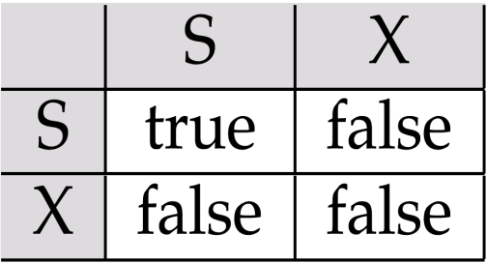
Lock-Based Protocols (Cont.)
Lock-compatibility matrix
A transaction may be granted a lock on an item if the requested lock is compatible with locks already held on the item by other transactions
Any number of transactions can hold shared locks on an item,
but if any transaction holds an exclusive on the item no other transaction may hold any lock on the item.
If a lock cannot be granted, the requesting transaction is made to wait till all incompatible locks held by other transactions have been released. The lock is then granted.

Slide 4
Lock-Based Protocols (Cont.)
Example of a transaction performing locking:
T₂: lock-S(A);
read (A);
unlock(A);
lock-S(B);
read (B);
unlock(B);
display(A+B)
Locking as above is not sufficient to guarantee serializability — if A and B get updated in-between the read of A and B, the displayed sum would be wrong.
A locking protocol is a set of rules followed by all transactions while requesting and releasing locks. Locking protocols restrict the set of possible schedules.

Slide 5
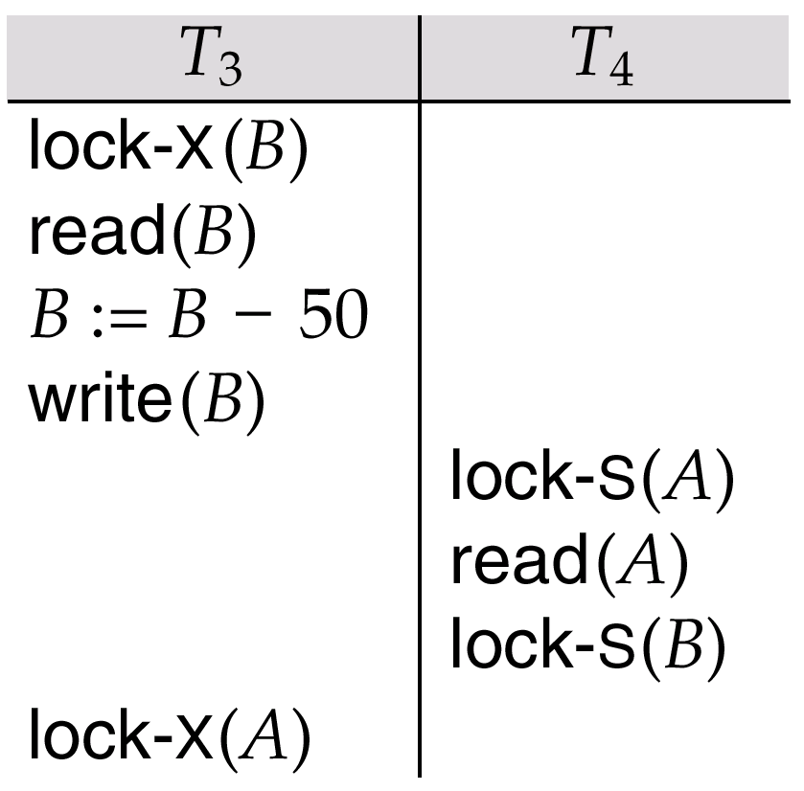
Pitfalls of Lock-Based Protocols
Consider the partial schedule
Neither T₃ nor T₄ can make progress — executing lock-S(B) causes T₄ to wait for T₃ to release its lock on B, while executing lock-X(A) causes T₃ to wait for T₄ to release its lock on A.
Such a situation is called a deadlock.
To handle a deadlock one of T₃ or T₄ must be rolled back and its locks released.

Slide 6
Pitfalls of Lock-Based Protocols (Cont.)
The potential for deadlock exists in most locking protocols. Deadlocks are a necessary evil.
Starvation is also possible if concurrency control manager is badly designed. For example:
A transaction may be waiting for an X-lock on an item, while a sequence of other transactions request and are granted an S-lock on the same item.
The same transaction is repeatedly rolled back due to deadlocks.
T1 | T2 | T3 | T4
 | lock-S(A)
lock-X(A) | … | lock-S(A)
Wait… | … | … | lock-S(A)
Wait… | … | … | …

Slide 7
The Two-Phase Locking Protocol
This is a protocol which ensures conflict-serializable schedules.
Phase 1: Growing Phase
transaction may obtain locks
transaction may not release locks
Phase 2: Shrinking Phase
transaction may release locks
transaction may not obtain locks
The protocol assures serializability. It can be proved that the transactions can be serialized in the order of their lock points (i.e. the point where a transaction acquired its final lock).

Slide 8

The Two-Phase Locking Protocol (Cont.)
Two-phase locking does not ensure freedom from deadlocks

Slide 9
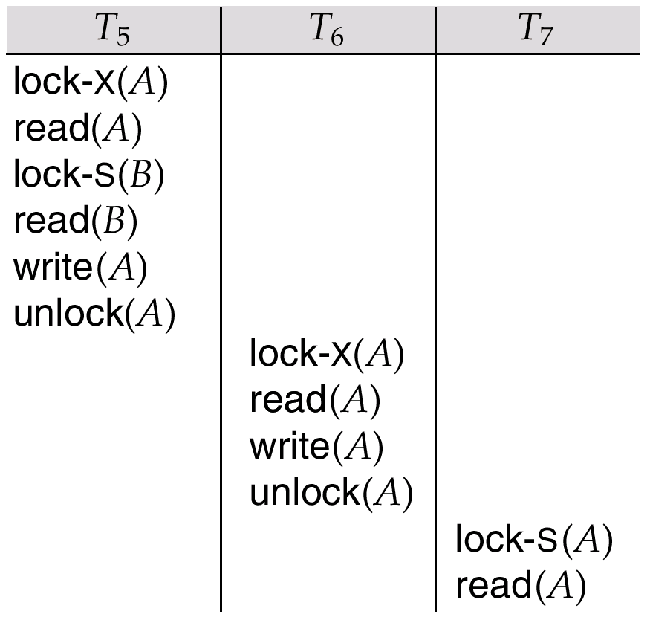
Partial Schedule Under Two-Phase Locking
Cascading roll-back is possible under two-phase locking.
To avoid this, follow a modified protocol called strict two-phase locking. Here a transaction must hold all its exclusive locks till it commits/aborts.
Rigorous two-phase locking is even stricter: here all locks are held till commit/abort. In this protocol transactions can be serialized in the order in which they commit.

Slide 10
Lock Conversions
Two-phase locking with lock conversions:
– First Phase:
can acquire a lock-S on item
can acquire a lock-X on item
can convert a lock-S to a lock-X (upgrade)
– Second Phase:
can release a lock-S
can release a lock-X
can convert a lock-X to a lock-S (downgrade)
This protocol assures serializability. But still relies on the programmer to insert the various locking instructions.

Slide 11
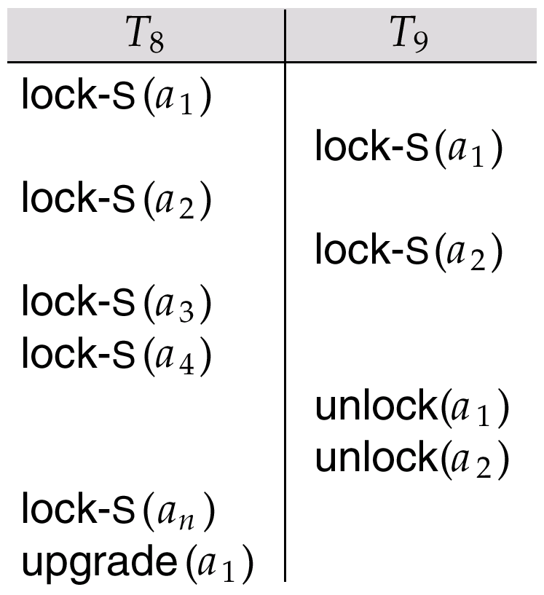
Incomplete Schedule With a Lock Conversion
T8:
Read(a1)
Read(a2)
……
Read(an)
Write(a1)
T9:
Read(a1)
Read(a2)
Display(a1 + a2)
T8 and T9 can access a1 and a2 simultaneously.
If we employ the two-phase locking protocol, then T8 musk lock a1 in X-mode. Then any concurrent execution of both transactions amounts to a serial execution.

Slide 12
Implementation of Locking
A lock manager can be implemented as a separate process to which transactions send lock and unlock requests.
The lock manager replies to a lock request by sending a lock grant messages (or a message asking the transaction to roll back, in case of a deadlock).
The requesting transaction waits until its request is answered.
The lock manager maintains a data-structure called a lock table to record granted locks and pending requests.
The lock table is usually implemented as an in-memory hash table indexed on the name of the data item being locked.

Slide 13
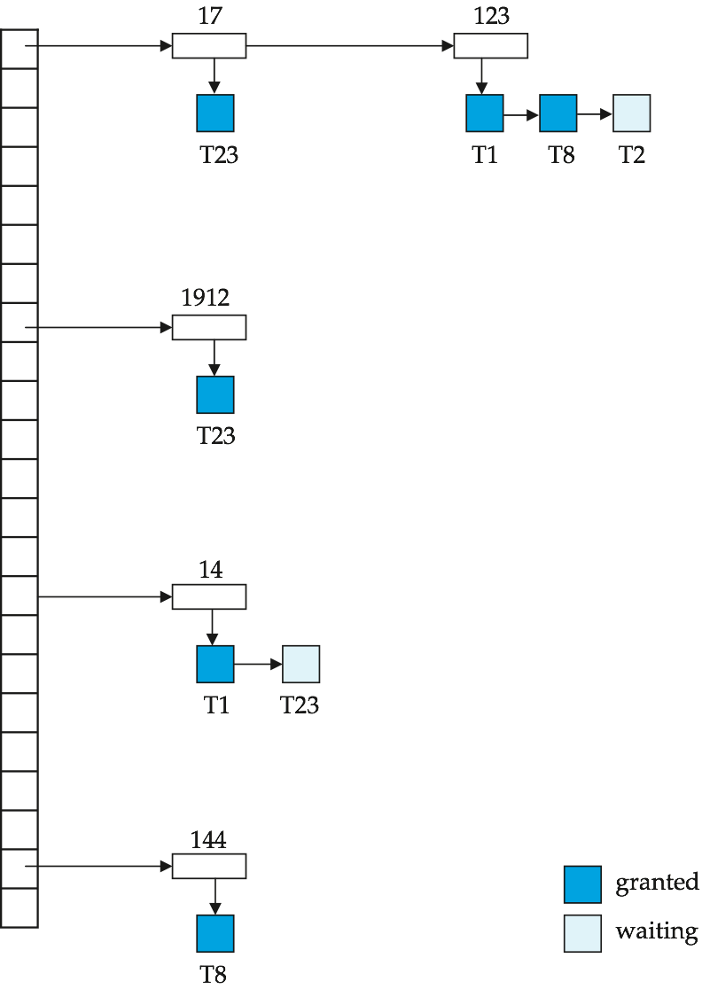
Lock Table
Deep blue rectangles indicate granted locks, light ones indicate waiting requests
Lock table also records the type of lock granted or requested
New request is added to the end of the queue of requests for the data item, and granted if it is compatible with all earlier locks
Unlock requests result in the request being deleted, and later requests are checked to see if they can now be granted
If transaction aborts, all waiting or granted requests of the transaction are deleted
lock manager may keep a list of locks held by each transaction, to implement this efficiently

Slide 14
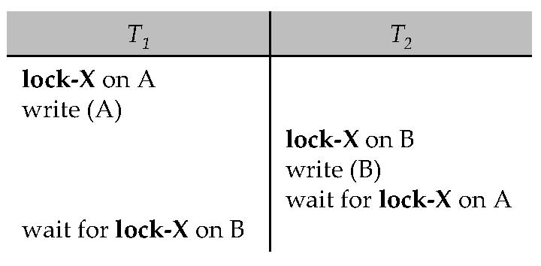
Deadlock Handling
Consider the following two transactions:
T₁: write (X) T₂: write(Y)
write(Y) write(X)
Schedule with deadlock

Slide 15
Deadlock Handling
System is deadlocked if there is a set of transactions such that every transaction in the set is waiting for another transaction in the set.
Deadlock prevention protocols ensure that the system will never enter into a deadlock state. Some prevention strategies :
Require that each transaction locks all its data items before it begins execution (predeclaration).
Impose partial ordering of all data items and require that a transaction can lock data items only in the order specified by the partial order.

Slide 16
More Deadlock Prevention Strategies
Following schemes use transaction timestamps for the sake of deadlock prevention alone.
wait-die scheme — non-preemptive
older transaction may wait for younger one to release data item. Younger transactions never wait for older ones; they are rolled back instead.
a transaction may die several times before acquiring needed data item
wound-wait scheme — preemptive
older transaction wounds (forces rollback) of younger transaction instead of waiting for it. Younger transactions may wait for older ones.
may be fewer rollbacks than wait-die scheme.

Slide 17
Deadlock prevention (Cont.)
Both in wait-die and in wound-wait schemes, a rolled back transactions is restarted with its original timestamp. Older transactions thus have precedence over newer ones, and starvation is hence avoided.
Timeout-Based Schemes :
a transaction waits for a lock only for a specified amount of time. After that, the wait times out and the transaction is rolled back.
thus deadlocks are not possible
simple to implement; but starvation is possible. Also difficult to determine good value of the timeout interval.

Slide 18
Deadlock Detection
Deadlocks can be described as a wait-for graph, which consists of a pair G = (V,E),
V is a set of vertices (all the transactions in the system)
E is a set of edges; each element is an ordered pair T_{i} →T_{j}.
If T_{i} → T_{j} is in E, then there is a directed edge from T_{i} to T_{j}, implying that T_{i} is waiting for T_{j} to release a data item.
When T_{i} requests a data item currently being held by T_{j}, then the edge T_{i} T_{j} is inserted in the wait-for graph. This edge is removed only when T_{j} is no longer holding a data item needed by T_{i}.
The system is in a deadlock state if and only if the wait-for graph has a cycle. Must invoke a deadlock-detection algorithm periodically to look for cycles.

Slide 19
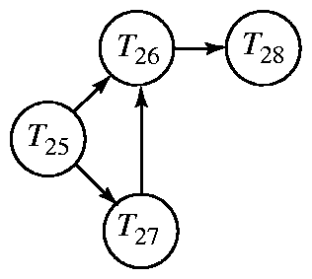
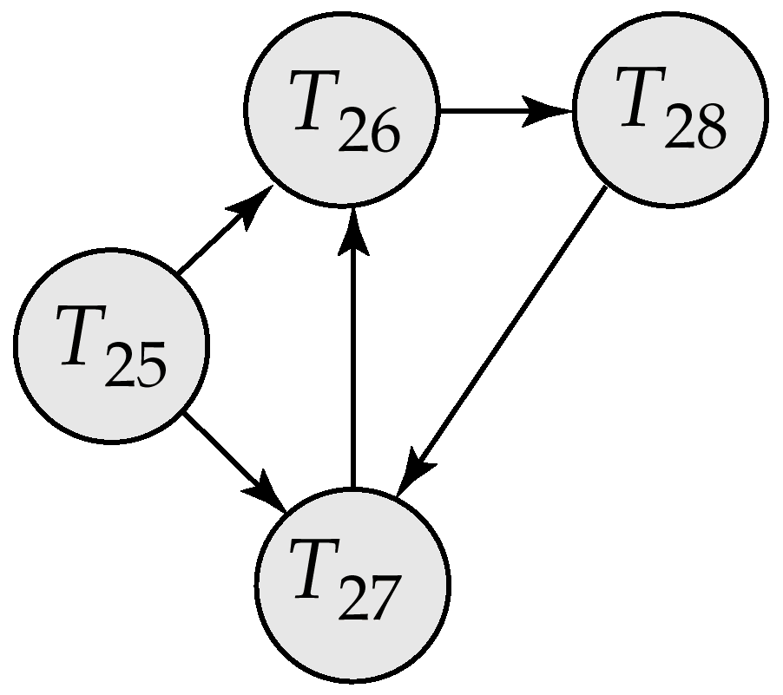
Deadlock Detection (Cont.)
Wait-for graph without a cycle
Wait-for graph with a cycle

Slide 20
Deadlock Recovery
When deadlock is detected :
Some transaction will have to rolled back (made a victim) to break deadlock. Select that transaction as victim that will incur minimum cost.
Rollback -- determine how far to roll back transaction
Total rollback: Abort the transaction and then restart it.
More effective to roll back transaction only as far as necessary to break deadlock.
Starvation happens if same transaction is always chosen as victim. Include the number of rollbacks in the cost factor to avoid starvation

Slide 21
Timestamp-Based Protocols
Each transaction is issued a timestamp when it enters the system. If an old transaction T_{i} has time-stamp TS(T_{i}), a new transaction T_{j} is assigned time-stamp TS(T_{j}) such that TS(T_{i}) <TS(T_{j}).
The protocol manages concurrent execution such that the time-stamps determine the serializability order.
In order to assure such behavior, the protocol maintains for each data Q two timestamp values:
W-timestamp(Q) is the largest time-stamp of any transaction that executed write(Q) successfully.
R-timestamp(Q) is the largest time-stamp of any transaction that executed read(Q) successfully.

Slide 22
Timestamp-Based Protocols (Cont.)
The timestamp ordering protocol ensures that any conflicting read and write operations are executed in timestamp order.
Suppose a transaction T_{i} issues a read(Q):
If TS(T_{i}) ≤ W-timestamp(Q), then T_{i} needs to read a value of Q that was already overwritten.
Hence, the read operation is rejected, and T_{i} is rolled back.
If TS(T_{i})≥ W-timestamp(Q), then the read operation is executed, and R-timestamp(Q) is set to max(R-timestamp(Q), TS(T_{i})).

Slide 23
Timestamp-Based Protocols (Cont.)
Suppose that transaction T_{i} issues write(Q).
If TS(T_{i}) < R-timestamp(Q), then the value of Q that T_{i} is producing was needed previously, and the system assumed that that value would never be produced.
Hence, the write operation is rejected, and T_{i} is rolled back.
If TS(T_{i}) < W-timestamp(Q), then T_{i} is attempting to write an obsolete value of Q.
Hence, this write operation is rejected, and T_{i} is rolled back.
Otherwise, the write operation is executed, and W-timestamp(Q) is set to TS(T_{i}).

Slide 24
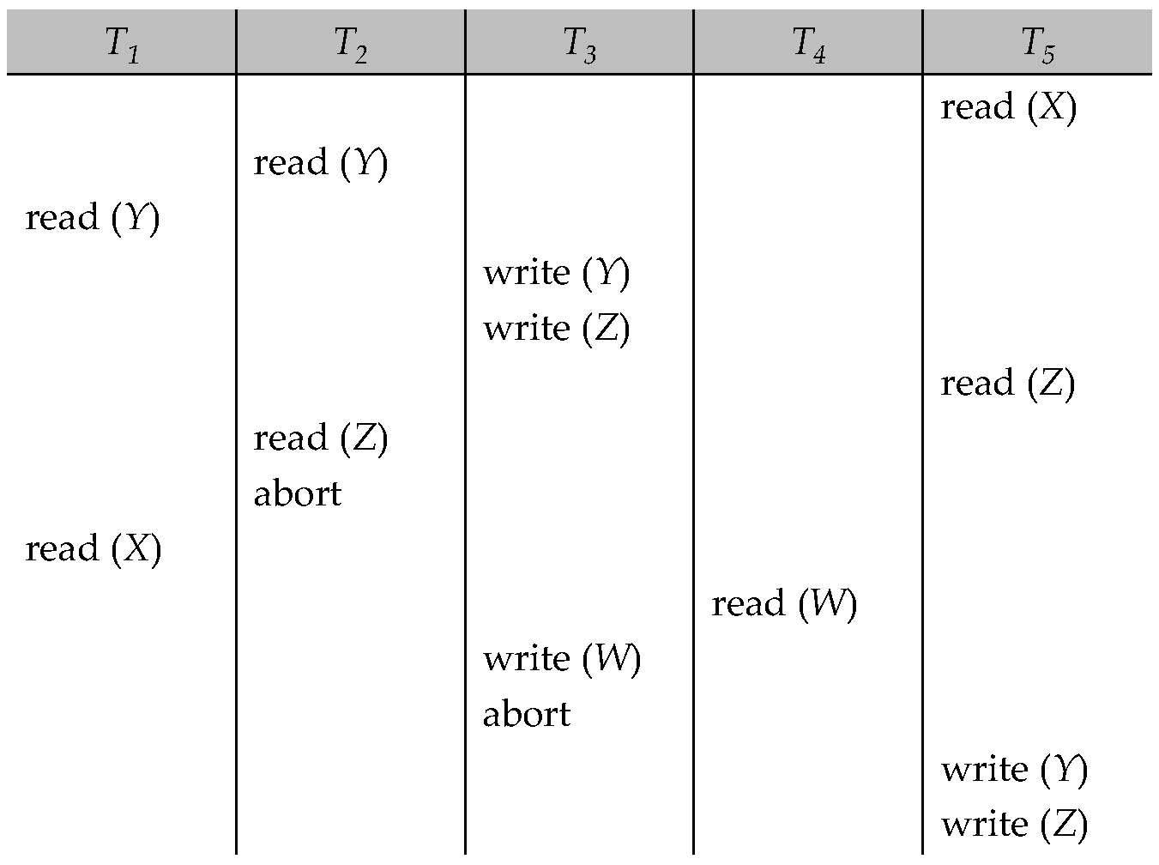
Example Use of the Protocol
A partial schedule for several data items for transactions with
timestamps 1, 2, 3, 4, 5

Slide 25
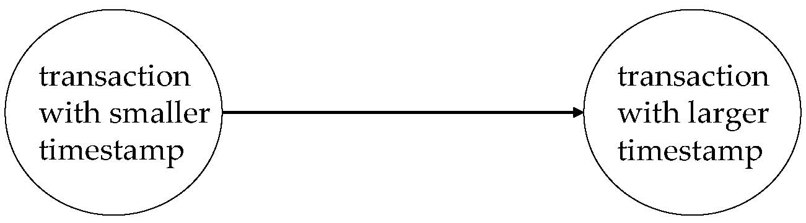
Correctness of Timestamp-Ordering Protocol
The timestamp-ordering protocol guarantees serializability since all the arcs in the precedence graph are of the form:
Thus, there will be no cycles in the precedence graph.
Timestamp protocol ensures freedom from deadlock as no transaction ever waits.
But the schedule may not be cascade-free, and may not even be recoverable.

Slide 26
Assignment
A scheduled flight has 50 tickets. Agency one wants to book 10 tickets and agency two want to book 20 tickets. Please design a lock strategy to implement the concurrency control.
Agency one | Agency two
Read(A)
 | Read(A)
A=A-10
Write(A)
 | A=A-20
 | Write(A)

Slide 27
End of Chapter

